Slide 1
Bank marketing campaigns dataset analysis
Done by:
Hammam Rafat Mohamed Hraesha 1906874
Abdulrhaman Turk 1800927

Slide 2
Overview
Introduction:
This is a dataset that describe Portugal bank marketing campaigns results. Conducted campaigns were based mostly on direct phone calls, offering bank's clients to place a term deposit. If after all marketing efforts, client had agreed to place deposit - target variable marked 'yes', otherwise 'no’.
Aim of the study:
To predict the future results of marketing companies based on available statistics and, accordingly, formulating recommendations for such companies in the future.

Slide 3
REFERENCES
Link to the dataset :
https://www.kaggle.com/volodymyrgavrysh/bank-marketing-campaigns-dataset
Citation to a preexisting solution:
This dataset is public available for research. The details are described in S. Moro, P. Cortez and P. Rita. "A Data-Driven Approach to Predict the Success of Bank Telemarketing." Decision Support Systems, Elsevier, 62:22-31, June 2014 <

Slide 4
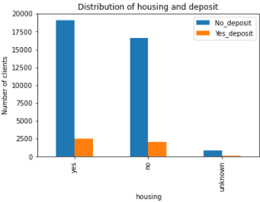
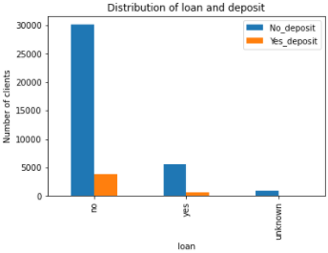
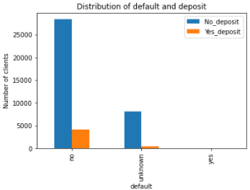
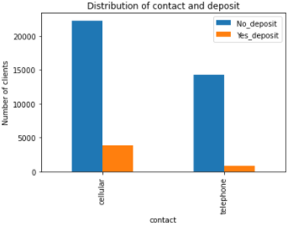
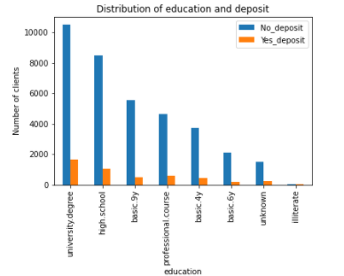
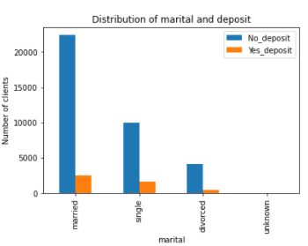
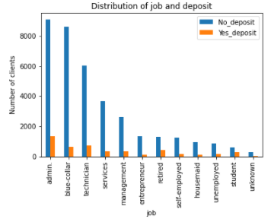
MAJOR FINDINGS OF THE ANALYSIS

Slide 5

Number of clients in relation to job position
Administrative staff and technical specialists opened the deposit most of all. In relative terms, a high proportion of pensioners and students might be mentioned as well.

Slide 6
Number of clients in relation to marital status
Although in absolute terms married consumers more often agreed to the service, in relative terms the single was responded better.

Slide 7
Number of clients in relation to FORM OF COMMUNICATION
Best communication channel is cellular.

Slide 8
Number of clients in relation to WHETHER THEY HAVE TAKEN A LOAN OR NOT
The difference is evident between consumers who already use the services of banks and received a loan.

Slide 9
Number of clients in relation to home ownership
Home ownership does not greatly affect marketing company performance.

Slide 10
SUMMARY OF THE DATASET
The dataset has 41188 rows (clients) with 21 columns (features)
Bank Client Data:
Related with the last contact of the current campaign:
other attributes:
age (numeric)
job (categorical)
marital (categorical)
education (categorical)
default: has credit in default? (categorical)
housing: has housing loan? (categorical)
loan: has personal loan? (categorical)
contact: contact communication type (categorical)
month (categorical)
day_of_week: (categorical)
duration: last contact duration, in seconds (numeric).
12. campaign: number of contacts performed during this campaign and for this client (numeric)
13. pdays: number of days that passed by after the client was last contacted from a previous campaign (numeric)
14. previous: number of contacts performed before this campaign and for this client (numeric)
15. poutcome: outcome of the previous marketing campaign (categorical)

Slide 11
SUMMARY OF THE DATASET Continued…
social and economic context attributes
Output variable (desired target):
16. emp.var.rate: employment variation rate - quarterly indicator (numeric)
17. cons.price.idx: consumer price index - monthly indicator (numeric)
18. cons.conf.idx: consumer confidence index - monthly indicator (numeric)
19. euribor3m: euribor 3 month rate - daily indicator (numeric)
20. nr.employed: number of employees - quarterly indicator (numeric)
21. y - has the client subscribed a term deposit? (binary: 'yes','no')

Slide 12
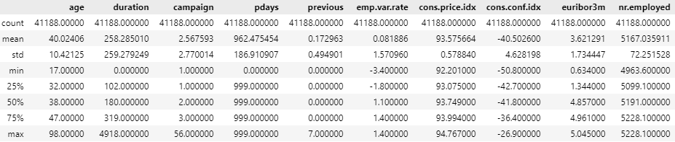
STATISTICAL DESCRIPTION OF THE DATASET

Slide 13

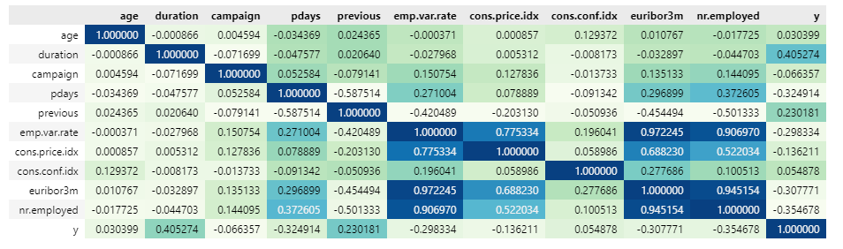
Correlation matrix

Slide 14
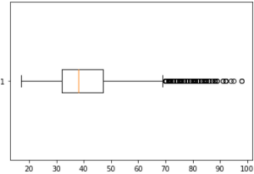
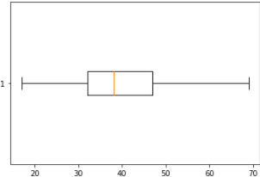
BOXPLOT DIAGRAM for age ATTRIBUTE
Before and after treating outliers.
Outliers are values less than 9.5 and greater than 69
Outliers were found using the IQR method

Slide 15
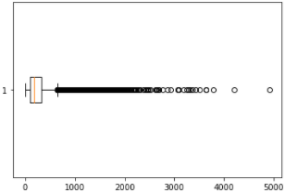
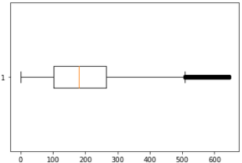
BOXPLOT DIAGRAM for DURATION ATTRIBUTE
Before and after treating outliers.
Outliers are values less than 0 and greater than 644
Outliers were found using the IQR method

Slide 16
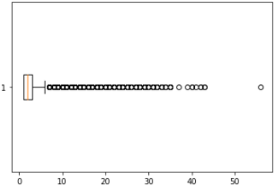
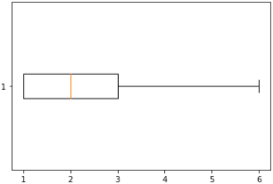
Boxplot diagram for campaign attribute
Before and after treating outliers
Outliers are values less than 1 and greater than 6
Outliers were found using the IQR method

Slide 17
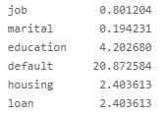
Percentage of missing values
Only categorical attributes have missing values.
Numbers are shown in percent.
Missing values in categorical attributes are denoted as “unknown” and were replaced to 0 in binary transformation

Slide 18
Data preprocessing
The data came from a single file, so no integration was needed.
Outliers were treated by replacing them with the median of the attribute
Categorical attributes were transformed into binary numbers (0 or 1).
Missing values were assigned as 0
Numeric values were scaled using various methods such as:
Normalization
Smoothing
Discretization

Slide 19
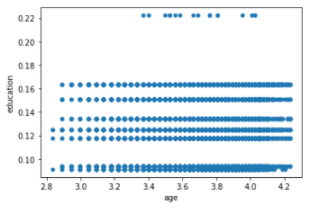
DATA VISUALIZATION AND ANALYSIS

Slide 20
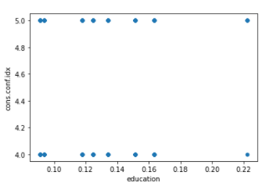
DATA VISUALIZATION AND ANALYSIS

Slide 21
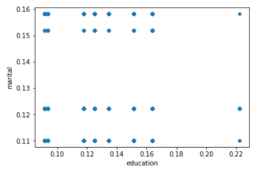

DATA VISUALIZATION AND ANALYSIS

Slide 22
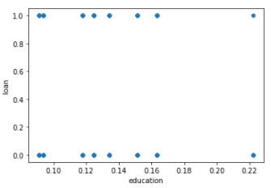

Data visualization and analysis

Slide 23
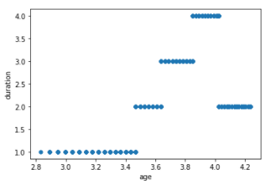

Data visualization and analysis

Slide 24
MACHINE LEARNING
ML method used is binary classification.
ROC_AUC evaluation metric was used.
Appropriate parameters were chosen by building a pipeline and using grid search.
Algorithms used:
Logistic Regression
Random Forest
K nearest neighbor
Decision tree
Bag
SGD

Slide 25
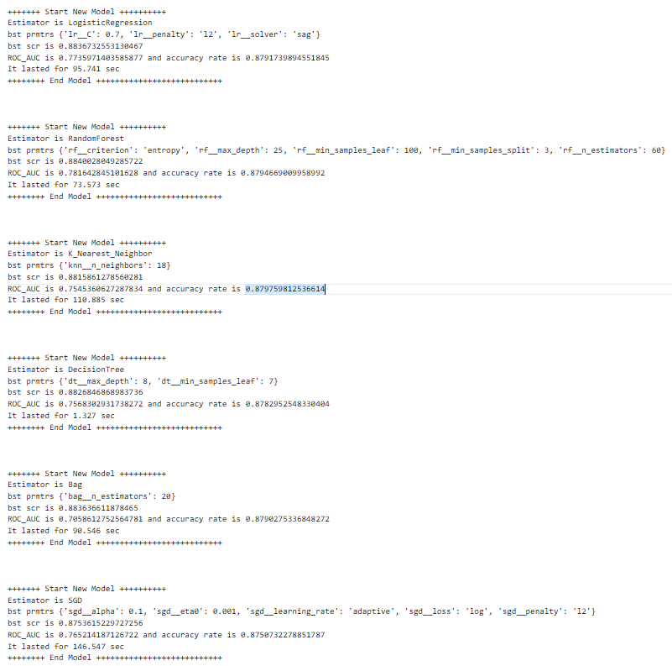
Results of DIFFERENT MODELS
Name of the ML algorithm, best parameters, best score, ROC_AUC result, and time taken are shown for each algorithm.

Slide 26
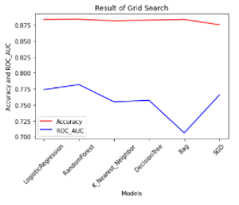
RESULT OF GRID SEARCH
Graph showing the accuracy and ROC_AUC score of different models.

Slide 27
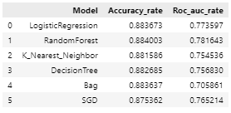
Chart showing the time and result of each model

Slide 28
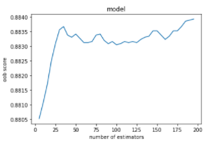
Graph to ensure the performance of randomforest algorithm

Slide 29
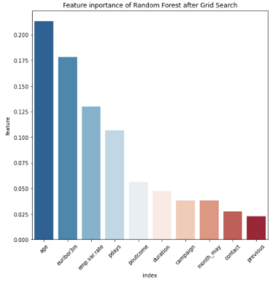
Bar chart for the features included in the final model
Features in the final model and their importance in the performance of Random Forest after Grid Search.

Slide 30
Findings of the STudy
This analysis can be carried out at the level of individual bank branches as does not require much resources and special knowledge (the model itself can be launched automatically with a certain periodicity).
Potentially similar micro-targeting will increase the overall effectiveness of the entire marketing company.
It is recommended to concentrate on those consumer groups that are potentially more promising.
The concentration of the bank’s efforts will effectively distribute the company’s resources to the main factor - the bank’s contact time with the client - it affects most of all on conversion.

